Slide 1
Maryland NextGen Testbank: Fundamentals Mini-Review

Slide 2
NextGen Test Bank Disclosures
This review uses items in the Maryland NextGen Test Bank accessed with a Qualtrics link or QR Code.
The Maryland Testbank contains peer-reviewed items written by faculty across the State of Maryland that attempt to align with publicly available information about Next Generation NCLEX.
The Maryland NextGen Test Bank Project was funded by the Maryland Nursing Workforce Center as part of a grant from the Maryland Higher Education Commission Nurse Support Program II # 20-125.
This review will take approximately 1.5 to 2 hours to complete.
For best result, use a laptop, notebook, or desktop to answer the questions.

Slide 3
About The NextGen NCLEX
Starting April 1, 2023, graduates will take an updated version of the National Council Licensure Exam referred to as Next Generation NCLEX.
Next Generation NCLEX (NGN) will continue to test a candidate’s ability to provide safe client care while incorporating new methods to better test clinical judgment.
The testing methods will include using new item response types in clinical judgment case studies and stand-alone questions to test the NCSBN Clinical Judgment Measurement Model(NCJMM) (https://www.ncsbn.org/exams/next-generation-nclex/NGN+Resources/clinical-judgment-measurement-model.page)

Slide 4
The Five New Item Response Types
Extended multiple response items with increased answer options.
Drag-and-drop items that involve moving options to placeholders.
Drop-down items where candidates select the missing words from sentences, paragraphs, or tables.
Highlight items that require candidates to identify parts of the medical record to answer questions.
Matrix/grid items that involve completing tables of information.

Slide 5
Case Studies
Unfolding case studies use approved NGN item types to answer questions about evolving real-world nursing scenarios.
Case studies present 6 linked questions to test the 6 steps of the NCJMM in order:
Recognize cues
Analyze cues
Prioritize hypotheses
Generate solutions
Take action
Evaluate outcomes
Candidates should expect to complete 3 to 5 case studies in a minimum length 85 question NCLEX exam.

Slide 6
Stand-alone Item Types
Stand-alone (single) items test either client needs or clinical judgment
Client needs items test knowledge of the 8 client needs using traditional or new item types.
Clinical judgment items present information in a clinical scenario specifically targeting one or more NCJMM clinical judgment step.
There are 2 unique types of clinical judgment stand-alone items:
Bowtie
Trend
Clinical judgment stand-alone items make up approximately 10% of stand-alone items.

Slide 7
Stand-alone Item: Bowtie
A bowtie is a drag-and-drop response item variation.
After reading a clinical scenario, candidates move response options (tokens) to placeholders (targets).
On NCLEX the placeholders are arranged in the shape of a bowtie.
Candidates must select:
1 condition the client is most likely experiencing from 4 options.
2 actions to take to address the condition from 5 options.
2 parameters to monitor the client’s progress from 5 options.

Slide 8
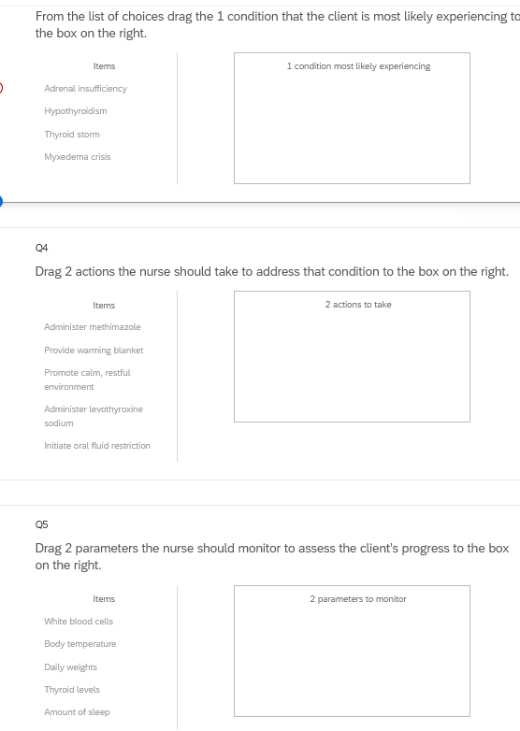
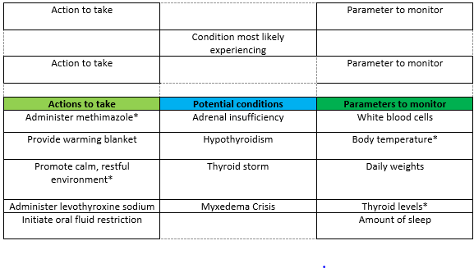
Bowties in Qualtrics
Bowties in Qualtrics are 3 drop and drag question- but they don’t make a “bowtie” shape.

Slide 9
Stand-alone Item: Trends
Trend items require the candidate to make clinical judgments based on client data presented at different time points.
Trend items may address one or more clinical judgment steps but do not follow the six-item sequence like case studies do.
Trend items can feature any item response type except bowtie.

Slide 10
About This Review
Your instructor will provide a QR code or link to answer a series of case studies, bowtie items and trends across a lifespan
While questions throughout the test bank use all 5 new item response, not all specific variations that might be used on NCLEX are not included such as drop-down items formatted as a table.
Information needed to answer questions will be displayed in a medical record, but the medical record will display differently on the actual NCLEX.
To see how items will exactly appear on NCLEX see tutorials at https://nclex.com/next-generation-nclex.page

Slide 11
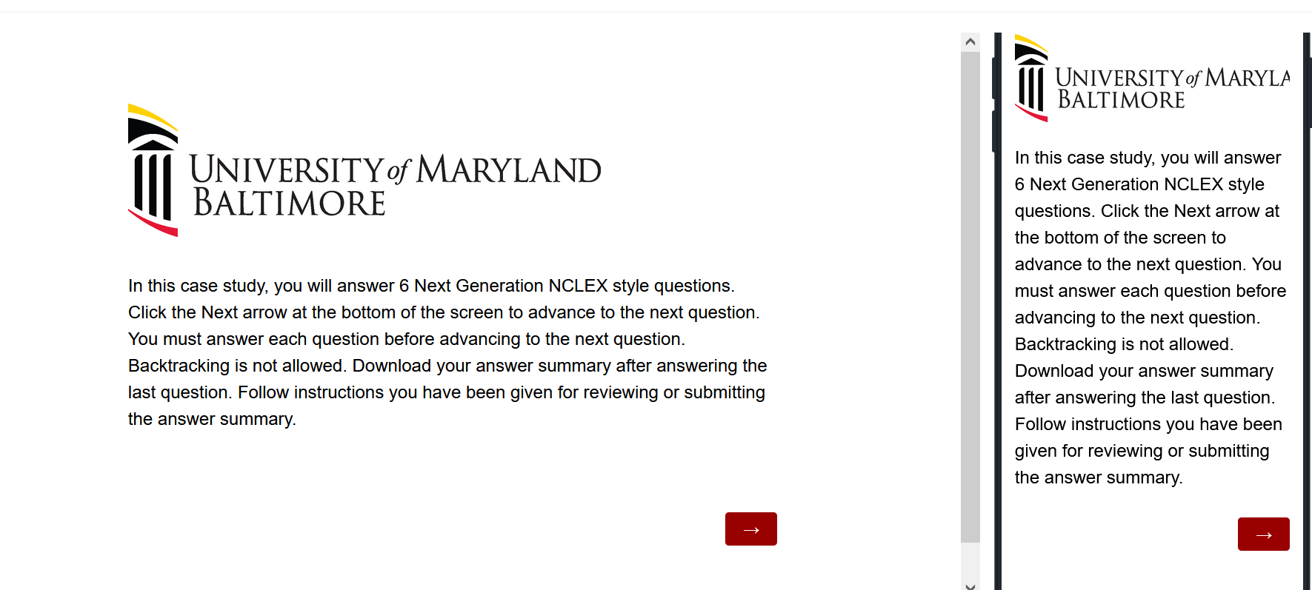
The First Screen Provides Instructions
Use the arrow to advance the screens
There is no backtracking

Slide 12
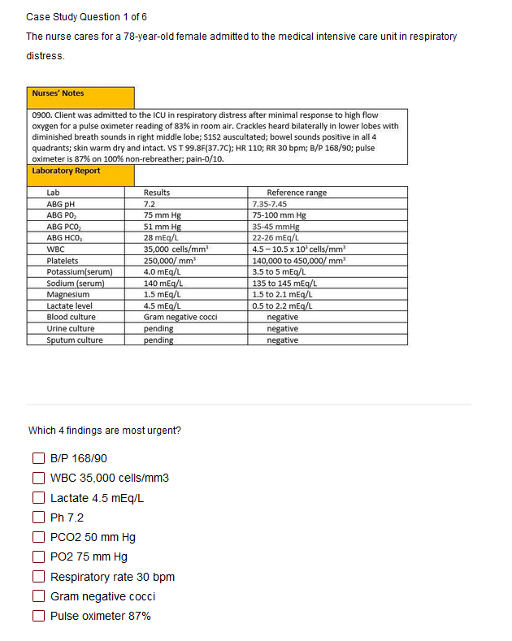

Answer the Questions
Read the instructions carefully.
Sometimes the question tells how many options to pick.
Other times you select all that apply.
Some questions will not allow you to advance if they have not answered enough options.
Use the arrow to advance to the next question if doing a case study

Slide 13
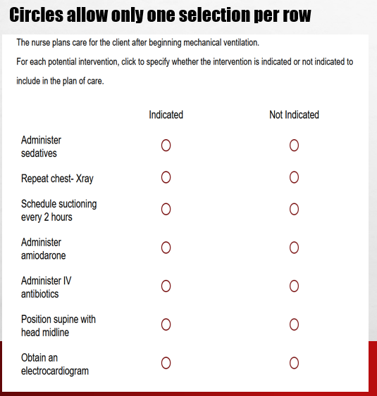
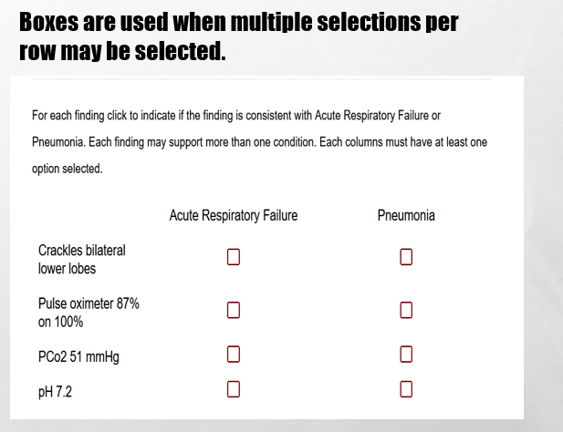
In Tables, Follow Instructions for How Many Options May be Selected in a Row.

Slide 14
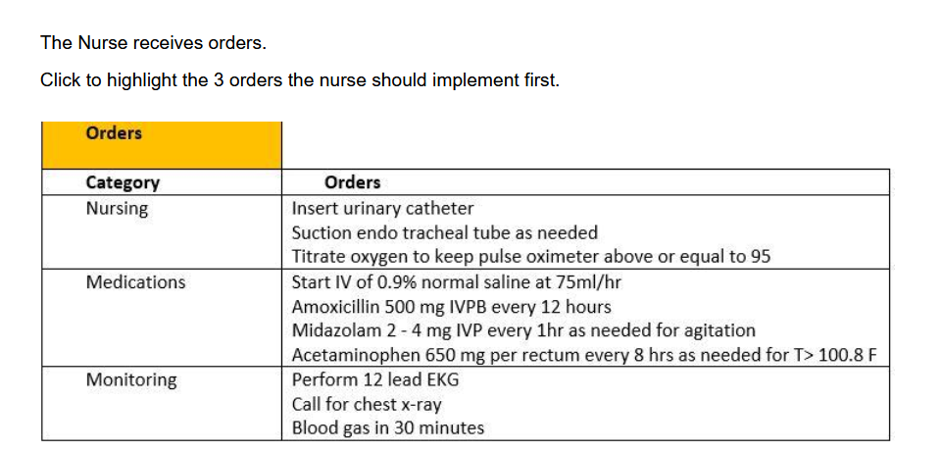
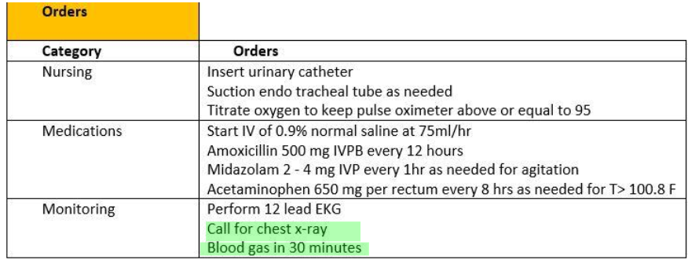
Highlight Questions
Questions first show a plain EMR page
Hovering curser makes boxes appear around selectable data
Click the box to apply the highlight; A second click removes it.

Slide 15
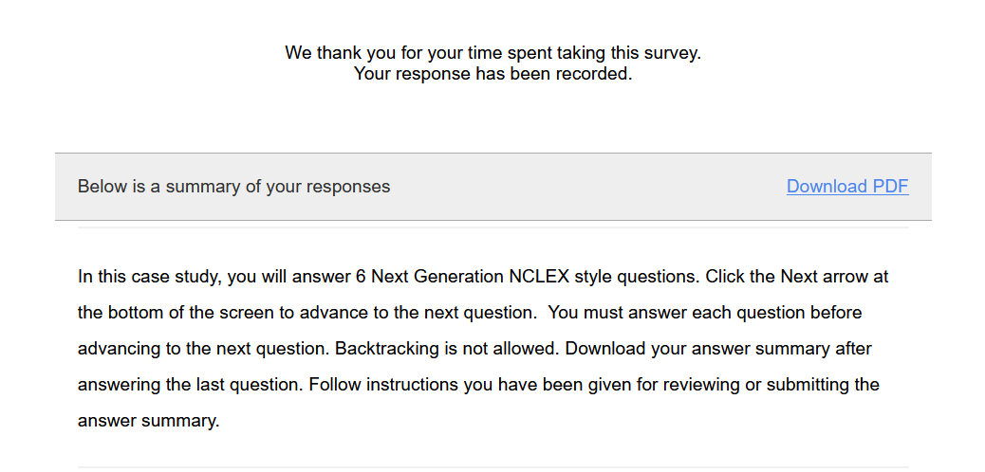
Submit the Final Question and Click Download PDF from Thank You Screen
It is the only way to save your answers.
This step is critical!

Slide 16
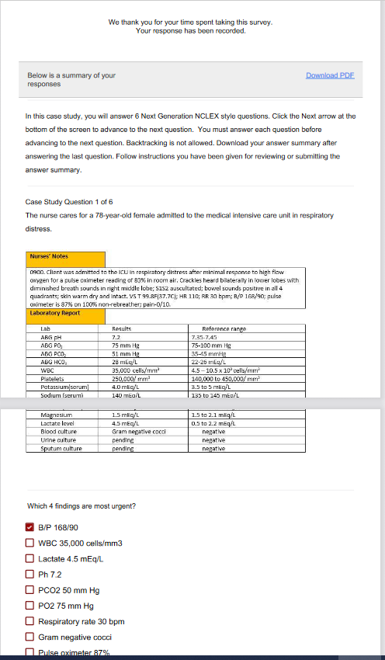
The Response Summary Shows Your Answers
Follow your faculty’s instructions for saving the response summary.
They may have you print it out, save it to computer, or upload it to a learning management system.
The response summary DOES NOT give you the correct answers.
Answers will appear on subsequent slides with information on how to score the item and a rationale for the answer.

Slide 17
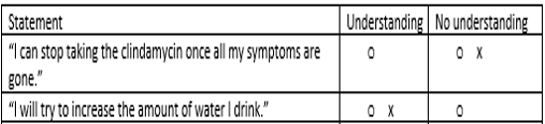
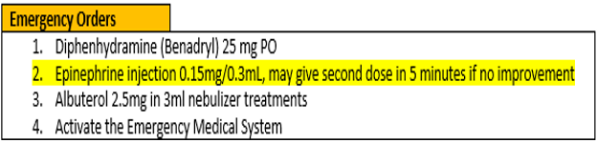
Correct Answers
Correct answers may be indicated 1 of 4 ways
Asterisk appears after correct option*
Option may be underlined with or without an *
Option may appear as an X or * in a table
Correct answer may appear as highlight

Slide 18
New Scoring Rule: +/-
Used when takers may pick unlimited options
Possible points are number of keyed correct items
Earn 1 point for each correct item selected
Loose 1 point for each incorrect item selected
Guessing penalty prevents takers from gaming system by selecting all
Minimum score =0
Which items are viruses? Select all that apply.
■ Chlamydia
■ Influenza[✓]
■ Hepatitis B [✓]
Lyme disease
Pertussis
Tuberculosis
Varicella [✓]
+/- Scoring rule
3 points possible
+2 correct
-1 incorrect
-----------------
1 points

Slide 19
New Scoring Rule: 0/1
Used when takers may select limited options
Possible points are number of keyed correct items
Earn 1 point for each correct item selected
Earn 0 points for incorrect responses
Minimum score 0
Which 3 items are viruses?
■ Chlamydia
■ Influenza[✓]
■ Hepatitis B [✓]
Lyme disease
Pertussis
Tuberculosis
Varicella [✓]
0/1 Scoring rule
3 points possible
+2 correct
-----------------
2 points

Slide 20
Same Answers: Different Scores
Select all that apply
Which 3 items are viruses?
■ Chlamydia
■ Influenza[✓]
■ Hepatitis B [✓]
Lyme disease
Pertussis
Tuberculosis
Varicella [✓]
Which items are viruses? Select all that apply
■ Chlamydia
■ Influenza[✓]
■ Hepatitis B [✓]
Lyme disease
Pertussis
Tuberculosis
Varicella [✓]
0/1 Scoring rule
3 points possible
+2 correct
-----------------
2 points
+/- Scoring rule
3 points possible
+2 correct
-1 incorrect
-----------------
1 point

Slide 21
Rationale Scoring Rule
Complete the sentence from list of dropdown options.
To prevent night blindness the nurse would recommend
because they are rich in vitamin
Used when question has linked concept and a justification in the same sentence
Example: The client most likely has an asthma exacerbation as evidenced by the breath sounds.
Dyad worth 1 point
One cause and one effect
Both parts must be correct for credit
Triad worth 2 points
One cause 2 effects
Cause must be right for any credit
Partial credit given (1 point) if only 1 effect is correct
almonds
carrots✓
orange juice
A
B
C✗
Right condition,
Wrong justification =0 points

Slide 22
Keep track of your score as you move through the review
Item | My score
Bow tie 1
Case study 1
Bowtie 1
Case study 2
Trend 1
Case study 3
Total Points

Slide 23
Final Link
The final link in the review takes you to the course evaluation.
This anonymous information will be used to help us understand how this review is being used and how to improve the experience.

Slide 24
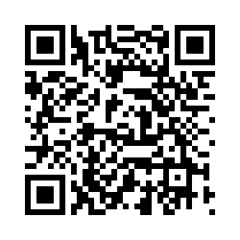
Bowtie # 1
URL
QR Code
https://umaryland.az1.qualtrics.com/jfe/form/SV_3e2Dw5IGoxrIW4m
Take 2-3 minutes

Slide 25
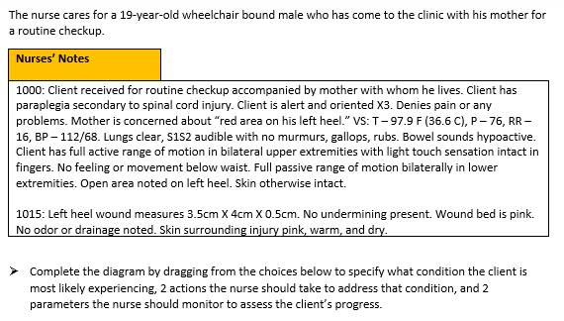
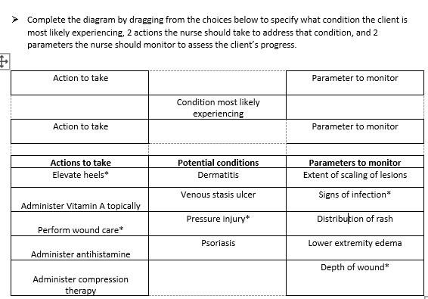
0/1. This item is worth 5 points. Give yourself 1 point for every correct selection

Slide 26
Rationale
The assessment data (location over bony prominence, shallow wound, surrounding skin within normal parameters) indicates a stage II pressure injury. Wound care will facilitate healing and elevating the heels while in bed will relieve direct pressure. The wound should be monitored for signs of infection. A decrease in wound depth would indicate that the pressure injury was improving.

Slide 27
Case Bowtie 1 Score
Question | Possible | My score
Conditions | 1
Actions | 2
Parameters | 2
Total | 5

Slide 28
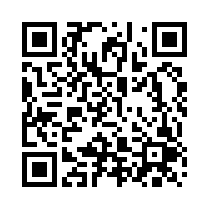
Case Study 1
URL
QR Code
https://umaryland.az1.qualtrics.com/jfe/form/SV_1RAIcNZ0SmsBAlE
Take about 10 minutes

Slide 29
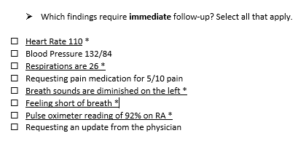
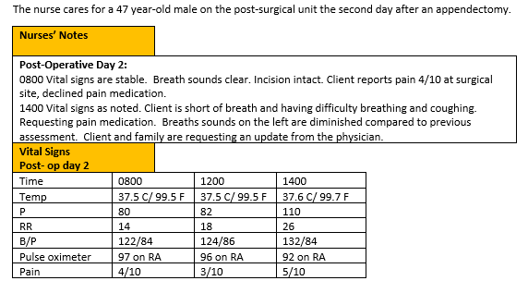
Screen 1 of 6
+/-. This question is worth 5 points.
Give yourself 1 point for each correct response AND subtract 1 point for every incorrect answer you picked. The worst you can score is 0.

Slide 30
Rationale
The nurse should identify signs and symptoms of post-operative complications that need to be addressed. Signs of atelectasis include increased heart rate, increased respirations, breathing difficulties and low oxygen levels. Breath sounds will be diminished due to collapsed alveoli. Blood pressure is not affected unless it becomes elevated due to the stress of breathing difficulties. Pain medication is important but first the breathing issues must be addressed.

Slide 31
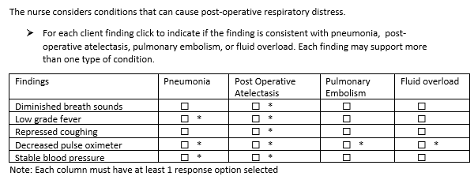
Screen 2 of 6
+/-. This question is worth 10 points. Score each column separately first, then add column scores together. Earn 1 point each correct item selected AND subtract point for each incorrect option you select. The worst you can score is 0 per column.
Column 1- 3 points
Column 2 -5 points
Column 3 -1 point
Column 4 -1point

Slide 32
Rationale
The nurse should differentiate signs and symptoms of atelectasis, pneumonia, pulmonary embolism, and fluid overload in clients with respiratory distress following surgery. All respiratory issues include shortness of breath and increased respirations, and decreased pulse oximeter readings. Diminished breath sounds and repressed coughing are most associated with post-op atelectasis. Coughing, rhonchi, wheezing, or crackles would be expected with the other three conditions. Low-grade fever and normal and stable blood pressures would be expected with atelectasis and pneumonia. Fever could also be higher with pneumonia. Unstable blood pressures would be expected for pulmonary embolism or fluid overload. Hypotension is typically seen with pulmonary embolism. Hypertension is associated with fluid overload.

Slide 33
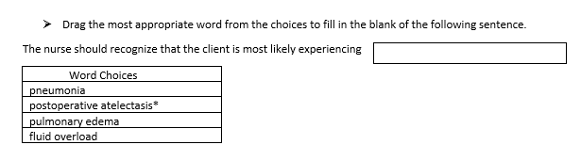
Screen 3 of 6
0/1. This question is worth 1 point.
Give yourself 1 point if you answered correctly.

Slide 34
Rationale
The client’s respiratory findings along with the diminished breath sounds, repressed cough, low grade fever and stable blood pressure most suggest the client is experiencing atelectasis.

Slide 35
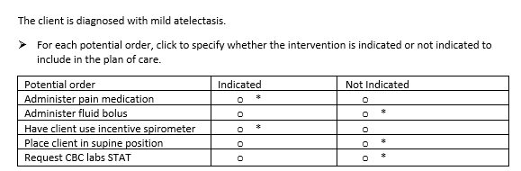
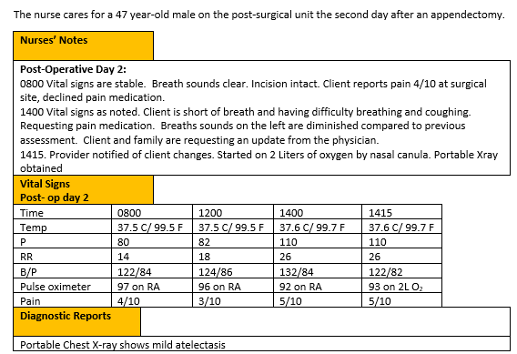
Screen 4 of 6
0/1. This item is worth 5 points. Give yourself 1 point for every row you got right.

Slide 36
Rationale
The XRAY confirms atelectasis. Proper nursing interventions include sitting the client up to aid with breathing. Supine position can make breathing more difficult. Applying oxygen via nasal cannula can also make breathing easier. Using the incentive spirometer can also make breathing easier. Controlling pain improves compliance with incentive spirometry. Extra fluid does not help a client with breathing and can put the client at risk for fluid overload. A CBC is not necessary for monitoring atelectasis as it would be for detecting and infection.

Slide 37
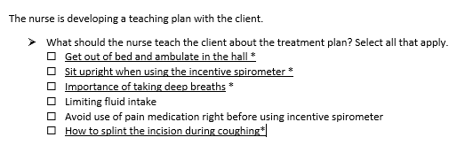
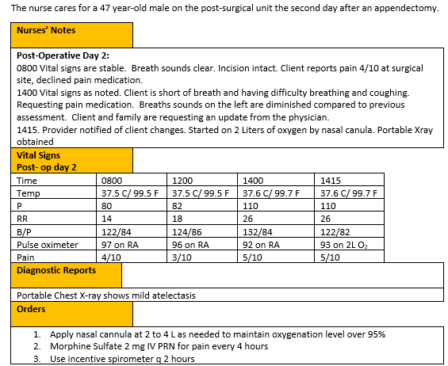
Screen 5 of 6
The
+/-. This item is worth 4 points. Give yourself 1 point for every correct option you picked AND subtract 1 point for every incorrect item you selected. The worst you can score is 0.

Slide 38
Rationale
The nurse should teach the client with atelectasis interventions that can improve their oxygenation. The nurse can instruct the client to be out of bed and ambulate, to take deep breaths in order to increase lung capacity and open up the alveoli. The incentive spirometer can also help improve lung function. The client should increase the fluids to about 3,000 ml /day to thin mucous secretions and use pain medication so they can take deep breaths.

Slide 39
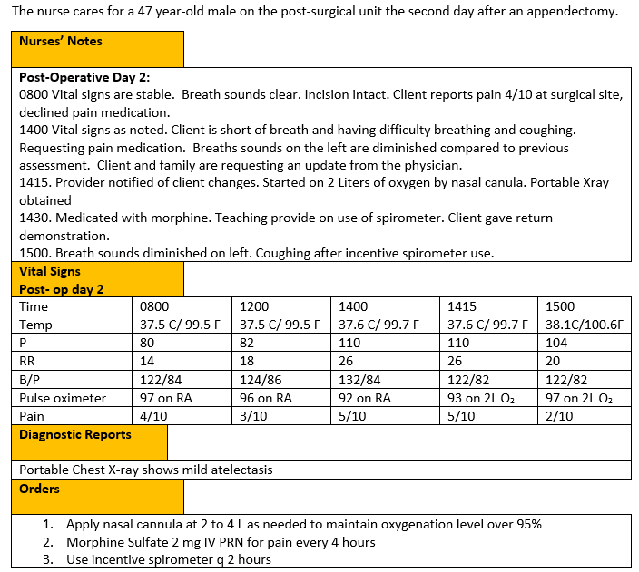
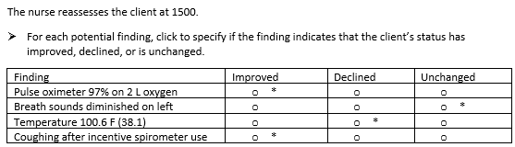
Screen 6 of 6
The
0/1. This item is worth 4 points. Give yourself 1 point for every row you got right.

Slide 40
Rationale
The nurse should recognize that the client has improved if the oxygen saturation is within normal limits and the client is coughing after using the incentive spirometer. Breath sounds were diminished on left and make take several cycles of deep breathing and coughing to improve. The increasing fever would indicate that the client’s condition had declined, and an infection may now be present.

Slide 41
Case Study 1 Score
Question | Possible | My score
1 | 5
2 | 10
3 | 1
4 | 5
5 | 4
6 | 4
Total | 29

Slide 42
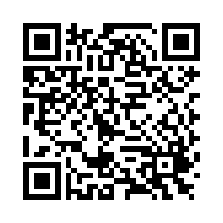
Bowtie # 2
URL
QR Code
https://umaryland.az1.qualtrics.com/jfe/form/SV_4VMW6Rt7x79A9E2
Take 2-3 minutes

Slide 43
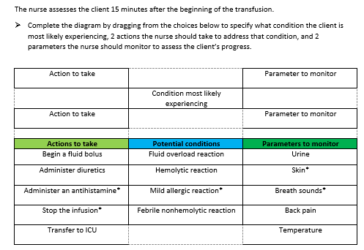
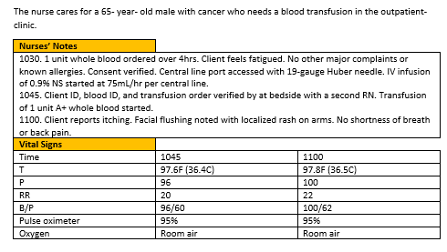
This item is worth 5 points. Give yourself 1 point for every correct selection.

Slide 44
Rationale
Based on the stable vital signs with skin changes, the nurse would most suspect that the client is having a mild allergic reaction to a foreign protein in the donor blood. The nurse should stop the transfusion and administer and antihistamine. The nurse would monitor the skin for improvement and the breaths sounds to ensure the allergic reaction is continuing to be mild versus anaphylaxis.

Slide 45
Bowtie 2 Score
Question | Possible | My score
Conditions | 1
Actions | 2
Parameters | 2
Total | 5

Slide 46
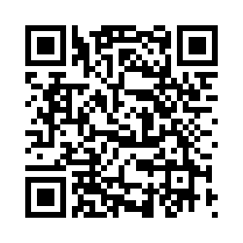
Case Study # 2
URL
QR Code
https://umaryland.az1.qualtrics.com/jfe/form/SV_6SuLbW1OlWYay4S
Take about 10 minutes

Slide 47
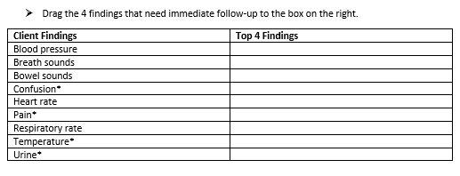
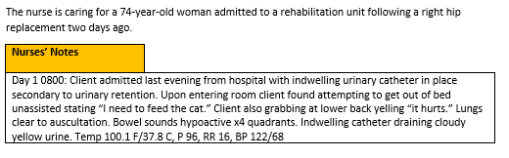
Screen 1 of 6
0/1. This question is worth 4 points.
Give yourself 1 point for each correct response.

Slide 48
Rationale
Vital signs, with exception of temperature heart rate, are similar to baseline. Heart rate, while elevated, is still within normal parameters and may be the result of the fever. Confusion, fever, cloudy urine, and lower back pain are new symptoms.

Slide 49
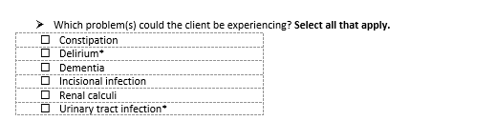
Screen 2 of 6
+/-. This question is worth 2 points. Give yourself a point for correct response you selected AND subtract 1 point for each incorrect response you selected. The worst you can score is 0.

Slide 50
Rationale
The client is experiencing acute confusion which had an abrupt onset (delirium) as opposed to chronic confusion (dementia). Confusion, along with fever, chills, and lower back pain are all signs of a UTI. There is no data to support the client being constipated or having an incisional infection. Renal calculi typically present with severe, sharp back and side pain.

Slide 51
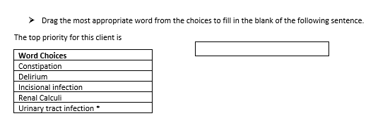
Screen 3 of 6
0/1. This question is worth 1 point.
Give yourself 1 point if you answered correctly.

Slide 52
Rationale
The signs and symptoms the client is experiencing, including delirium, suggest UTI. There is no indication that the client is constipated, has renal calculi, or has an incisional infection.

Slide 53
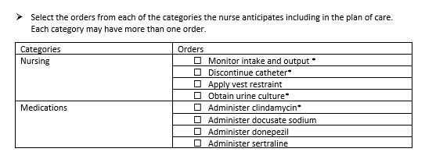
Screen 4 of 6
+/-.This question is worth 4 points. Score each group separately first, then add group scores together. Earn 1 point each correct item selected AND subtract 1 point for each incorrect option you select. The worst you can score is 0 per column.
Nursing- 3 points
Medications – 1 point

Slide 54
Rationale
A UTI is suspected. Since the client has an indwelling catheter, a culture should be sent, the catheter discontinued, and clindamycin started to treat the infection. It is important to monitor intake and output once the catheter is discontinued since the client previously experienced urinary retention. The client should not be restrained without trying other interventions first. A stool softener, antidepressant, and dementia medication are not indicated.

Slide 55
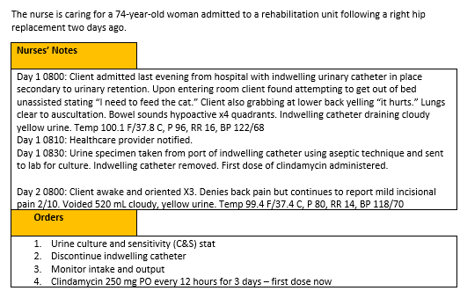
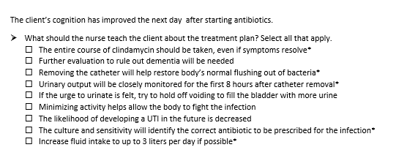
Screen 5 of 6
The
+/-. This item is worth 5 points. Give yourself 1 point for every option you got right AND subtract 1 point for every incorrect item you selected. The worst you can score is 0.

Slide 56
Rationale
The client likely has CAUTI. Sending a C&S will determine 1) if there is an infection and 2) if the appropriate antibiotic is prescribed. Removing the catheter eliminates the mode of transmission and helps to restore the body’s natural flushing out of bacteria. Increased fluid intake will also help to flush out the bacteria. The full course of antibiotics should be taken even if symptoms resolve. The nurse should monitor the client’s voiding pattern to identify potential urinary retention. Evaluation for dementia is not necessary as the client likely had delirium because of the UTI. The client should void when the urge is felt as bacteria can multiply when holding urine.

Slide 57
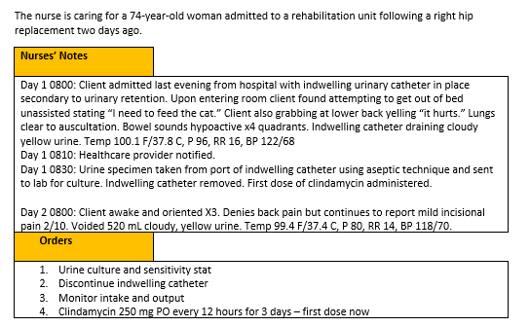
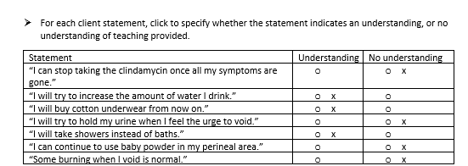
Screen 6 of 6
The
0/1. This item is worth 7 points. Give yourself 1 point for every row you got right.

Slide 58
Rationale
The client should drink eight 8-ounce glasses of water a day to flush bacteria out of the urinary system. Cotton enhances ventilation of the perineal area and helps prevent accumulation of perineal moisture with facilitates bacterial growth. The bacteria present in bath water can readily enter the urethra. The full course of clindamycin should be finished even if symptoms resolve. The client should practice frequent voiding to flush bacteria out of the urethra and prevent organisms from ascending into the bladder. The use of harsh soaps, bubble bath, powder, or sprays in the perineal areas should be avoided. These substances can be irritating to the urethra and encourage inflammation and bacterial infection. Burning with urination is not normal. It may indicate recurrence of UTI.

Slide 59
Case Study 2 Score
Question | Possible | My score
1 | 4
2 | 2
3 | 1
4 | 4
5 | 5
6 | 7
Total | 23

Slide 60
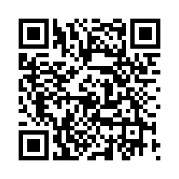
Trend # 1
URL
QR Code
https://umaryland.az1.qualtrics.com/jfe/form/SV_efcwkK8NCyL231Y
Take 2-3 minutes

Slide 61
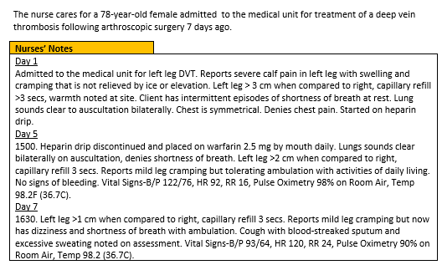
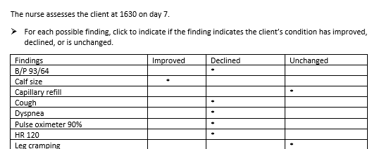
0/1. This question is worth 8 points.
Give yourself 1 point for each row you got correct.

Slide 62
Rationale
When reviewing the assessment findings, the nurse should understand that sudden shortness of breath, low oxygen saturation levels, coughing up blood, increased heart rate, and low blood pressure are consistent with signs of a pulmonary embolism. A pulmonary embolism is a serious medical emergency that can be life threatening. In a pulmonary embolism a dislodged blood clot travels to the pulmonary artery. There is no change to the client’s capillary refill or leg cramping since day 5. The client’s calf size has improved.

Slide 63
Trend 1 Score
Question | Possible | My score
Points | 8
Total | 8

Slide 64
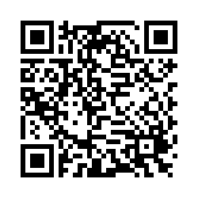
Case Study # 3
URL
QR Code
https://umaryland.az1.qualtrics.com/jfe/form/SV_5dt5N3y7rCEg7mS
Take about 10 minutes

Slide 65
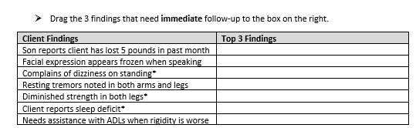
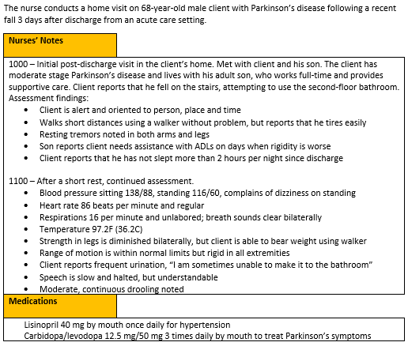
Screen 1 of 6
0/1. This question is worth 3 points.
Give yourself 1 point for each correct response.

Slide 66
Rationale
Dizziness is symptom related to orthostatic hypotension and can be a side effect of lisinopril. This puts the client at increased risk for falls. Sleep disturbance is not a normal part of aging and needs additional assessment, as fatigue can increase fall risk. The diminished strength in the client’s legs also increases his risk for falls.

Slide 67
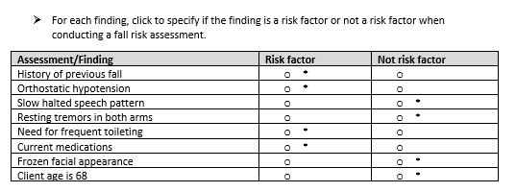
Screen 2 of 6
0/1. This question is worth 8 points.
Give yourself 1 point for each row you got correct.

Slide 68
Rationale
Medications causing orthostatic hypotension may increase the risk for falls, need for frequent toileting increases need for mobility and use of stairs, history of a fall is a known risk factor for additional falls; advanced age, > 80, is considered a fall risk.

Slide 69
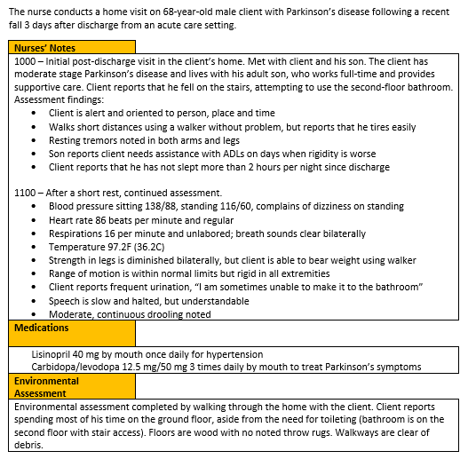
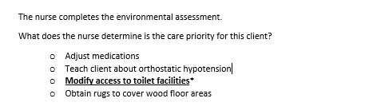
Screen 3 of 6
0/1. This question is worth 1 point.
Give yourself 1 point if you answered correctly.

Slide 70
Rationale
Modifying access to toilet facilities will address the client’s only need to use the stairs and reduce his risk for falls. This is an intervention that will increase client’s quality of life and have limited associated expense.

Slide 71
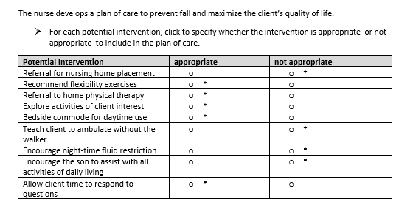
Screen 4 of 6
0/1. This question is worth 9 points. Give yourself 1 point for each row you got correct.

Slide 72
Rationale
The client is not ready for extended care facility placement. Flexibility exercises, such as yoga or tai chi, will help promote range-of-motions and balance. Home physical therapy will help maintain strength and flexibility. A bedside commode will enable the client to use the toilet without climbing stairs. Exploring activities of interest and allowing the client time to respond to questions will help keep client engaged and prevent social isolation.
A fluid restriction is not indicated, based on signs of dehydration. Promoting as much independence as possible in self-care is important to client self-esteem. Due to client’s decreased strength and orthostatic hypotension, he should be encouraged to use the walker when ambulating.

Slide 73
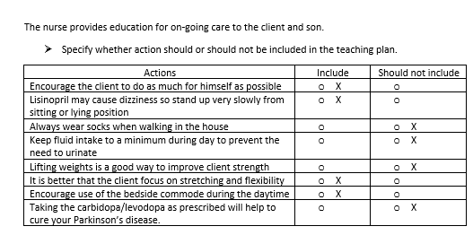
Screen 5 of 6
The
0/1. This item is worth 8 points. Give yourself 1 point for every row you got correct.

Slide 74
Rationale
Clients with Parkinson’s disease should be encouraged to participate in self-care for as long as possible. This helps with both motor skills and self-esteem. Lisinopril can cause orthostatic hypotension, so instruction on standing up slowly is important. Wearing socks on the wood floor increases the risk for falls. Instead, the client should always wear shoes. Making the toilet more accessible is a healthier option to decreasing fluid because dehydration can contribute to the risk for falls. Weightlifting is not considered a safe activity for clients with decreased strength. Focus on flexibility and stretching is more beneficial that strength training in Parkinson’s disease. Using the bedside commode is a safety intervention to prevent the use of stairs when unattended. Parkinson’s disease is a progressive degenerative disease that will not be cured by medication. Carbidopa/levodopa can help with symptoms of shakiness and trouble moving, but will not prevent disease progression.

Slide 75


Screen 6 of 6
The
0/1. This item is worth 7 points. Give yourself 1 point for each row you got correct .

Slide 76
Rationale
Changes in cognition such as confusion and irritability and declining speech capability are signs of progressing disease. No fall shows in 3 months shows interventions have been effective. Joining a support group and an online yoga class demonstrate an understanding of disease progression and positive interventions. The client was using a walker and had dizziness upon standing at the initial visit.

Slide 77
Case Study 3 Score
Question | Possible | My score
1 | 3
2 | 8
3 | 1
4 | 9
5 | 8
6 | 7
Total | 36

Slide 78
My Total
Item | Possible Points | My score
Bow tie 1 | 5
Case study 1 | 29
Bowtie 1 | 5
Case study 2 | 23
Trend 1 | 8
Case study 3 | 36
Total Possible | 106

Slide 79

Please Complete the Mini Review Evaluation
https://umaryland.az1.qualtrics.com/jfe/form/SV_1ZYu3gxvlMDziMS
This evaluation will take approximately less than 2 minutes to complete.

